Slide 1
Perceptive Car Parking Booking System With IOT Technology
Ashwin Ashok
S4-mca

Slide 2
Relevance of the topic
Due to more utilization of vehicle within the site visitors congestion takes place on the street because the finding of loose parking slot, takes greater time. As a result we lose parking slot, takes greater time. As a result we lose certain quantity of time and more than 75% to 85% of fuel wastage on searching the empty parking slot inside the parking location. To solve this problem, we want a unique device inside the parking area to degree empty space and show the statistics to the people searching out the empty space. However, some systems designed formerly to avoid time wastage in automobile parking area.

Slide 3
description
A system for parking reservations and security, maintenance in a private car parking field in an urban metropolis. This system design is used to eliminate unnecessary time conception to find an empty slot in a car parking field. The reservation processes are happening only by the user. Hence the user visit parking area using an android application through an internet access and find the empty parking slot and a reserve parking slot as per their preference. It deals with the major response to user’s reservation action and thus the driver can set aside his own likely parking slot based on the time and cost function . I have projected a system with multi-processing queuing mechanism (MPQM) to avoid multi-user approach problem (MUAP) during the reservation procedure in our perceptive car parking booking arrangement based on IOT technology. In our system all the user can able to reserve own likely parking spot. Hence there is no restriction between the slot reservation, and user request. Here the user reserves his spot with respect the system framework described

Slide 4
OBJECTIVES OF THE STUDY
This system work systematically detects the non- reserved parking slot and updates the data in server side using web page which is designed for the distinct parking area and also prints the report of the car that has been placed in the slot.
This system is efficient and useful in metropolitan cities. This system can be applied to avoid dense traffic in the parking areas like shopping malls, theaters, tourist spots and other busy areas, thereby cutting time and the use of the fuel and contamination.

Slide 5
EXISTING SYSTEM
In the existing system i want to find the car slot by myself without knowing the free space. In order to that there is wastage of fuel and time .In the big cities the availability of the free space is very few. So searching is not possible in that case.

Slide 6
PROPOSED SYSTEM
It is assumed that driver have smart phone and have installed the android app and have internet connection . Moving towards smart parking is a very good example for a common citizen of how the IOT can be efficiently and effectively used in our day to day life it provides different services to different users. Conventional reservation based car parking method has a limitation of space and time. Proposed smart parking system providing the free parking slot efficiently that saves times, fuel and reduces atmosphere pollution and congestion in cities. This design “IOT based car parking system” was designed such that the status of the parking slot can be known and it can be reserved from anywhere in the users smart phone.

Slide 7
INPUT AND OUTPUT
INPUT-THE DISTANCE TAKEN BY THE SENSOR
OUTPUT- SLOT AVAILABILITY

Slide 8
MODULES
1.USER APPLICATION
USER
SECURITY OFFICER
ADMIN
2.SERVER
3.DATABASE
4.PARKING SLOT ARRANGEMENT

Slide 9
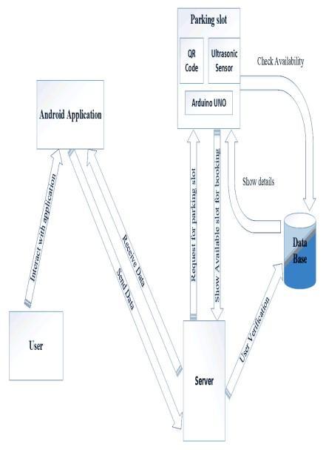
METHODOLOGY

